Slide 1
Relational Calculus

Slide 2
Relational Calculus
Relational calculus is non procedural, it is a language for expressing what we want without expressing. Relational calculus has a variable.
For tuple relational calculus, the variable ranges over the tuples of a relation.
For domain relational calculus, the variables ranges over the values of the domain.

Slide 3
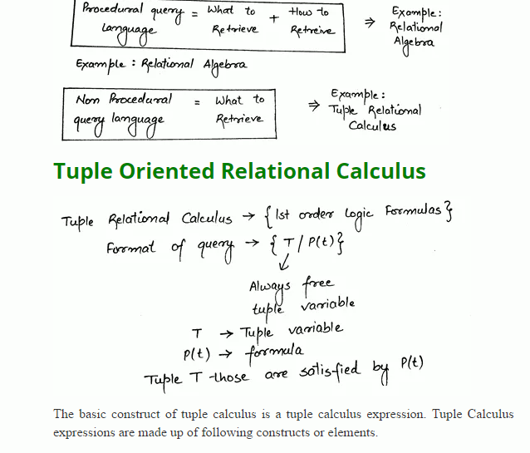

Slide 4
Tuple Variable : A tuple variable is a variable that ‘ ranges over’ some named relation i.e. a variable whose only permitted values are tuples of that relation.
Tuple variables are denoted by uppercase letters. For example T, U, V etc. If the tuple variable T represents tuple t (at given time), then the expression T. A represents the A component of t( at that time), where A is an attribute of the relation over which T Ranges.
Conditions : Conditions are of the form x * y, where * is any relational operator =, !=, <, <=, >, >= and at least one of the x & y is an expression of the form T.A & other is either a similar expression or a constant.

Slide 5
Well Formed Formulas (WFFs) : A WFF is constructed from conditions, Boolean operators ( AND, OR, NOT) and quantifiers (∃, ∀) according to the following rules:
Every condition is WFF.
If f is a WFFs, then (f) and NOT(f) are also WFFs.
If f and G are WFFs, then (f AND g) and (f oOR g) are also WFFs.
If f is WFF in which T occurs as a free variable then ∃T(f) are WFFs.
Nothing else is a WFF.
Criteria for free and bound variables :
Within the condition all tuple variable occurrences are free.
Tuple variable occurrence in the WFFs(f), NOT(f) are free/bound according as they are free/bound in f.
Tuple variable occurrences in the WFFs(f AND g), (f OR g) are free/bound according as they are free/bound in f or g.

Slide 6
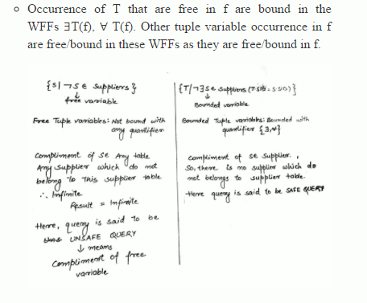

Slide 7
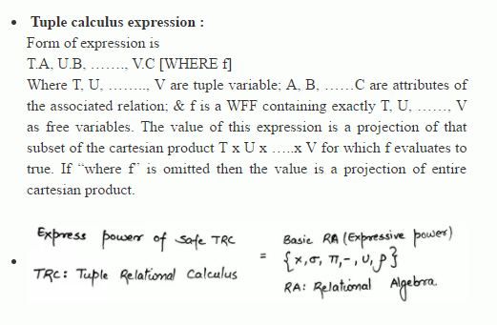

Slide 8
Domain Oriented Relational Calculus
The domain oriented relational calculus differs from the tuples calculus in that its variable ranges over domain rather than relations. Expressions of the domain calculus are constructed from the following elements.
Domain Variables : Domain variables are denoted by uppercase letters. For example D,E,F etc. Each domain variable is constrained to range over some specified domain.
Conditions : Conditions can takes two forms :
Simply comparisons : Form is x * y, same as for the tuple calculus, except that x and y are now the domain variables ( or constants).
Membership Condition : The form is R (term, term, …..). Here R is a relation and each “term” is a pair A : V, where A is an attribute of R and V is either a domain variable or a constant.

Slide 9
Well Formed Formulas (WFFs): Same as tuple calculus section but with revised definition of condition
Free and Bound Variables : Same as tuple calculus.
Domain Calculus Expressions : A domain calculus expression is then an expression of the form D, E, ….., F [WHERE f] where D, E, ….., F are domain variables and f is a WFF containing exactly D, E, ….., F are free variables. The values of this expression is that subset of the cartesian product D x E x …. x F (where D, E, ….., F range over all their possible values) for which f evaluated to true – or if “WHERE f” is omitted that entire cartesian product.

Slide 10
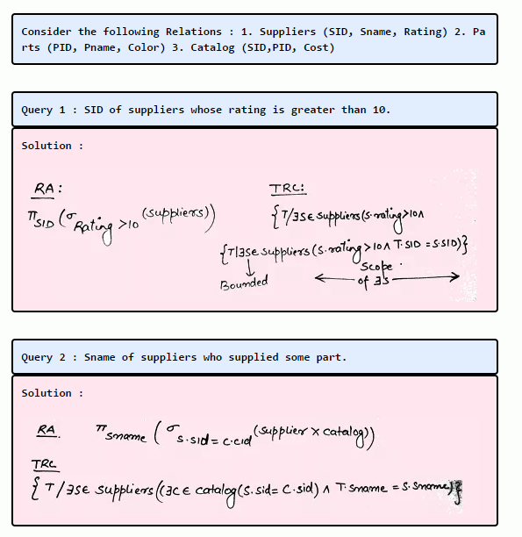

Slide 11
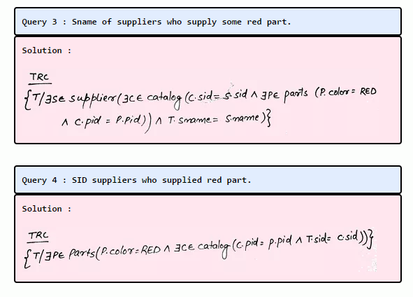

Slide 12
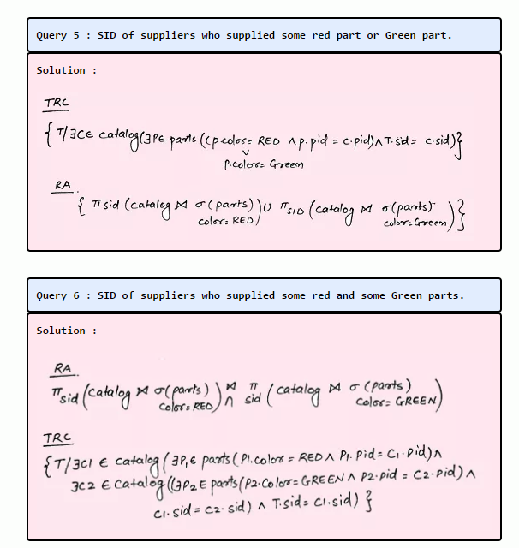

Slide 13
